Slide 1
Basic Calculator Using Python and Tkinter
Rakesh Devendrasing Pardeshi
Next Hikes IT Solution

Slide 2
Introduction
The project is a basic calculator developed using Python.
It allows users to perform fundamental arithmetic operations: addition, subtraction, multiplication, and division.
Developed using Tkinter, Python’s standard GUI library.

Slide 3
Library Used
Tkinter:
Python's standard GUI library (comes built-in).
Provides widgets like Button, Label, Grid, etc.
Enables event-driven programming for interactive apps.
Why Tkinter?
Lightweight and easy to learn.
Ideal for simple desktop GUI applications.

Slide 4
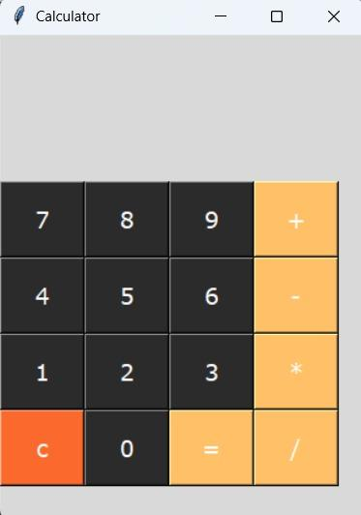

Slide 5
Challenges & How I Overcame Them
Challenge | How It Was Overcome
Division by zero | Used an if condition to detect and show "Error".
Handling empty/invalid input | Wrapped logic in try/except blocks.
Dynamic button functions | Used lambda functions to pass parameters cleanly.
Layout management | Used grid() method for structured button placement.

Slide 6
References
Python Documentation: https://docs.python.org/3/library/tkinter.html
Tkinter Tutorials: Real Python, GeeksforGeeks

Slide 7
Thank You !

